Slide 1

Dept. of Computer Science and Engineering
AI-BASED CONTACTLESS HEALTH MONITORING USING THERMAL IMAGING
CHRIST (Deemed To Be University)
NAME : SHARBIN I
REG NO : 2567111
GUIDED BY : Dr.Shamanth N
Dr.Vandana Reddy
MISSION
CHRIST is a nurturing ground for an individual’s holistic development to make effective contribution to the society in a dynamic environment
VISION
Excellence and Service
CORE VALUES
Faith in God | Moral Uprightness Love of Fellow Beings
Social Responsibility | Pursuit of Excellence

Slide 2
Introduction
Healthcare is increasingly moving towards smart, non-invasive, and contactless monitoring to improve patient safety and enable early disease detection. Traditional monitoring methods require physical contact and separate medical devices to measure vital signs, making them less suitable for remote healthcare and large-scale screening. This project proposes a Smart Contactless Health Monitoring System Using Thermal Imaging, which combines thermal imaging, image processing, and artificial intelligence to estimate vital signs such as body temperature, respiratory rate, pulse rate, and blood oxygen saturation (SpO₂). The system provides real-time health monitoring and supports early identification of respiratory and cardiovascular abnormalities, making it suitable for hospitals, public health screening, and resource-constrained healthcare environments.

Slide 3
Domain:
Image Processing + Artificial Intelligence & Machine Learning (AI/ML)
CHRIST
Deemed to be University
Sub-domains:
Thermal Image Processing
Edge Computing
IoT

Slide 4
Problem Statement
CHRIST
Deemed to be University
Traditional health monitoring systems rely on contact-based devices that require physical contact, regular sanitization, and separate instruments to measure different vital signs. These limitations make them less suitable for remote healthcare, large-scale screening, and infectious disease management. Therefore, there is a need for a smart contactless health monitoring system using thermal imaging and AI to provide real-time, non-invasive estimation of vital signs and support early disease detection.

Slide 5
Literature Review (Recent Papers)
CHRIST
Deemed to be University
Year/ Journal / Publication | Paper | Existing Work | Methodology
2026/ Sensors(MDPI) | Adaptive Thermal Imaging Signal Analysis for Real-Time Non-Invasive Respiratory Rate Monitoring | Contactless respiratory rate monitoring | YOLO, Kalman Filter, Thermal Signal Analysis
2026/Biomedical Signal Processing and Control | Thermal Imaging for Contactless Cardiorespiratory Monitoring | Heart rate and respiratory rate estimation | ROI Tracking, Thermal Imaging, AI-based Signal Processing
2025/IEEE Access | Contactless Monitoring of Human Vital Signs Using Infrared Thermal Imaging | Respiratory and thermal monitoring | Deep Learning, Thermal Feature Extraction
2025/Sensors (MDPI) | Deep Learning-Based Thermal Face Analysis for Healthcare Monitoring | Facial thermal pattern analysis | CNN, Thermal Image Processing
2025/IET Image Processing | Real-Time Contactless Vital Sign Monitoring Using Thermal Imaging and Edge AI | Edge-based healthcare monitoring | Edge AI, Thermal Imaging, TensorFlow Lite
Excellence and Service

Slide 6
Literature Review (Recent Papers)
CHRIST
Deemed to be University
Year/ Journal / Publication | Paper | Existing Work | Methodology
2025/ IEEE Journal of Biomedical and Health Informatics | AI-Assisted Thermal Imaging for Respiratory Disease Detection | Respiratory disease screening | CNN, Transfer Learning
2024/ IEEE Access | Non-Invasive Monitoring of Vital Signs Using Thermal Imaging | Heart rate and respiratory rate monitoring | KCF Tracking, Signal Processing/
2024/Sensors (MDPI) | Thermal Camera-Based Vital Sign Monitoring System for Smart Healthcare | Remote patient monitoring | Thermal ROI Detection, Deep Learning
2024/ Biomedical Signal Processing and Control | Contactless Cardiovascular Monitoring Through Thermal Facial Imaging | Cardiovascular parameter estimation | Facial Thermal Analysis, Machine Learning
2024/ IEEE Access | Contactless Vital Sign Monitoring Using Deep Learning and Computer Vision Techniques | Real-time heart rate and respiratory rate estimation from facial videos | CNN, Computer Vision, Deep Learning
Excellence and Service

Slide 7
Literature Review (Recent Papers)
CHRIST
Deemed to be University
Year/ Journal / Publication | Paper | Existing Work | Methodology
2023/ IEEE Access | Contactless Vital Sign Estimation Using Thermal and RGB Imaging | Multi-modal vital sign monitoring | Thermal-RGB Fusion, Deep Learning
2023/ Sensors (MDPI) | Thermal Imaging-Based Respiratory Rate Monitoring Using Artificial Intelligence | Respiratory pattern recognition | CNN, Feature Extraction
2023/ IET Healthcare Technology Letters | Edge AI Enabled Thermal Healthcare Monitoring System | Real-time healthcare analytics | Edge Computing, TensorFlow Lite
2023/ IEEE Access | Contactless Respiratory Monitoring Using Thermal Imaging and Artificial Intelligence | Real-time respiratory monitoring and abnormal breathing detection | Thermal Imaging, Deep Learning, ROI Tracking
2023/ IEEE Journal of Biomedical and Health Informatics | Contactless Physiological Monitoring Using Facial Thermal Imaging | Facial thermal biomarker analysis | Computer Vision, Machine Learning
Excellence and Service

Slide 8
Base Paper (2026)
“Adaptive Thermal Imaging Signal Analysis for Real-Time Non-Invasive Respiratory Rate Monitoring”
Published: 2026
Journal: Sensors (MDPI)
Methodology:
Thermal camera
YOLO object detection
Kalman filtering
Adaptive signal processing
Edge computing

Slide 9
Research Gap
Existing contactless health monitoring systems mainly focus on one or two vital signs, such as body temperature or respiratory rate.
Most studies rely on separate devices or wearable sensors for monitoring multiple physiological parameters.
Very few systems integrate thermal imaging, AI, and edge computing into a single platform for multi-vital sign estimation.
There is limited research on real-time prediction of respiratory and cardiovascular disorders using contactless thermal imaging.
.

Slide 10
Objectives
To create a facial thermal image and video dataset for contactless health monitoring.
To develop a contactless thermal imaging system for estimating vital signs such as body temperature, respiratory rate, pulse rate, and blood oxygen saturation (SpO₂).
To implement AI/ML models for the prediction of respiratory and cardiovascular disorders.
To develop an edge-based real-time health monitoring system with analytics, emergency alerts, and validation for early detection of respiratory and thermal health conditions.

Slide 11
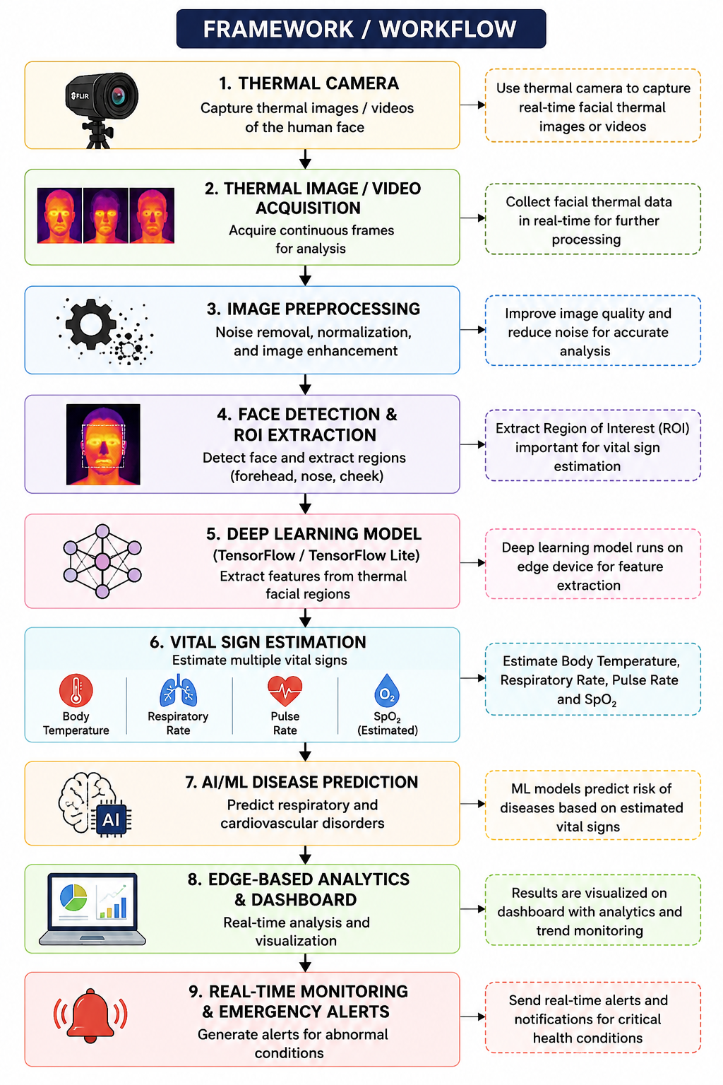
Work Flow

Slide 12
Conclusion
The proposed system demonstrates the potential of thermal imaging and AI for contactless health monitoring. It provides real-time estimation of multiple vital signs, supports early disease prediction, and offers a safe, non-invasive solution for modern healthcare, making it suitable for hospitals, remote healthcare, and public health screening.

Slide 13
References
F. Yang, S. He, S. Sadanand, A. Yusuf, and M. Bolic, "Contactless Measurement of Vital Signs Using Thermal and RGB Cameras: A Study of COVID-19-Related Health Monitoring," Sensors, vol. 22, no. 2, p. 627, 2022. doi:10.3390/s22020627.
T. Negishi, S. Abe, T. Matsui, H. Liu, M. Kurosawa, T. Kirimoto, and G. Sun, "Contactless Vital Signs Measurement System Using RGB-Thermal Image Sensors and Its Clinical Screening Test on Patients with Seasonal Influenza," Sensors, vol. 20, no. 8, p. 2171, 2020. doi:10.3390/s20082171.
"Contactless Vital Sign Monitoring: A Review Towards Multi-Modal Multi-Task Approaches," Sensors, vol. 25, no. 15, p. 4792, 2025.
C. Álvarez Casado, M. Rahman, S. Sharifipour, et al., "Thermal Imaging for Contactless Cardiorespiratory and Sudomotor Response Monitoring," 2026.
"Adaptive Thermal Imaging Signal Analysis for Real-Time Non-Invasive Respiratory Rate Monitoring," Sensors, 2026.
"Thermal Cameras for Continuous and Contactless Respiration Monitoring: A Review," Sensors, 2024
"Non-Contact Vision-Based Techniques of Vital Sign Monitoring: A Systematic Review," Healthcare, 2024
"Thermal Cameras for Overnight Measuring of Respiration in a Clinical Environment," Sensors, 2025.
"Contactless Camera-Based Heart Rate and Respiratory Rate Monitoring Using AI on Hardware," Sensors, 2023.
"Remote Photoplethysmography for Vital Signs Monitoring: A Review," Sensors, vol. 21, no. 18, p. 6296, 2021.

Slide 14
Thank You

